Slide 1
Domain Specific Document Summarization through Hierarchical Classification using Transformers
Group No -08
Team Members
Sathwika Karingu (11708107)
Vivek Nelluri (11691249)
Hemanth Addepalli (11665107)
Chilukuri Tagore Reddy (11652327)

Slide 2
Introduction
The project's field of study is about text sorting and summarizing. It wants to automate the process of analyzing and shortening big amounts of written data.
The reason for doing this work comes from a desire to handle large quantities information in text form, like scientific articles, more effectively by using technology.
The importance of this project is diverse. It presents a solution to the issue of excessive information by allowing articles to be automatically classified into appropriate categories and producing brief summaries, thereby making it easier for people to swiftly find pertinent details
The project's work is demonstrated in showing how to use different machine learning and deep learning methods for processing text, like document embedding with Doc2Vec, classification via logistic regression or neural networks as well as support vector machines plus summarization using BART.

Slide 3
Problem statement/Hypothesis
The problem of this project is about how to analyze and understand a big amount of text data, focusing on scientific articles from the Pubmed dataset. The goal is to create automatic ways for classifying and summarizing text in order to solve these main problems:
Information Overload
Resource Intensity
Inconsistent Analysis
The idea that supports this project is we can make use of machine learning and deep learning methods like Doc2Vec for document embedding, logistic regression, neural networks, support vector machines as well as BART to do summarization. This has the potential to create systems for text classification and summarizing which are precise and effective.

Slide 4
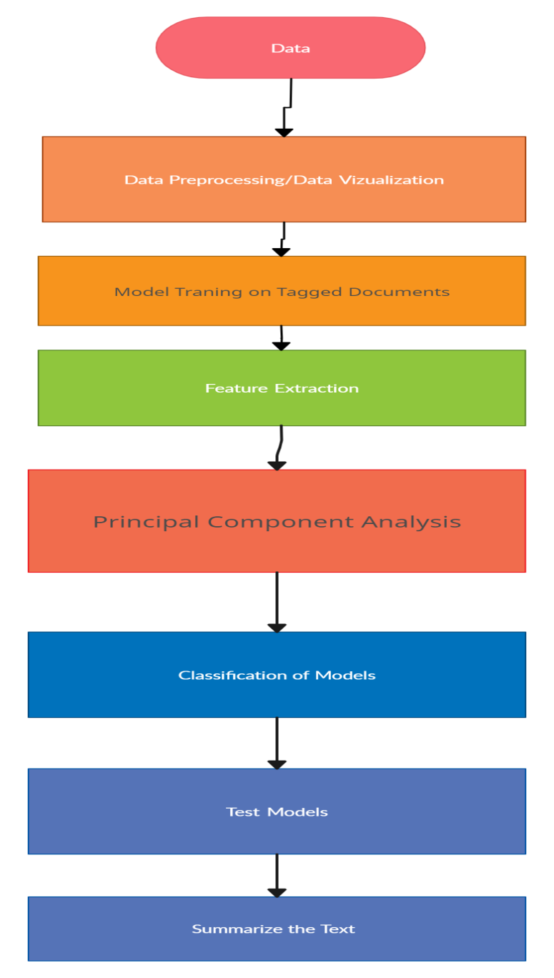
Work Flow Diagram
Model/Methodolgy:-In the project's methodology, we follow many steps starting from preparing data to training and assessing various machine learning and deep learning models. The general workflow and structure are as follows:

Slide 5
Workflow Explanation
Data preprocessing:
Load the dataset containing scientific articles from the pubmed dataset..
Doc2vec model training:
Use the tokenized abstracts to train a doc2vec model, which can produce document embeddings that retain semantic information from the text.
Dimensionality reduction with pca:
Apply principal component analysis (PCA) to reduce the dimensionality of the document embeddings for visualization.
Data visualization:
Create a 3D scatter plot, where each point is a document embedding and color indicates article labels.

Slide 6
Continuation
Model training:
Train multiple models for text classification and summarization:
Logistic regression model
Neural network models (simple and complex architectures)
Support vector machine (SVM) classifier
Evaluation:
Assess the models that have been trained on a test set, employing measurements like precision, recall, f1-score and accuracy.
Summarization with bart:
Utilize the BART (bidirectional and auto-regressive transformers) model for text summarization.

Slide 7
Dataset
This dataset consists of an approx. 50k collection of research articles from pubmed repository. Originally these documents are manually annotated by biomedical experts with their mesh labels and each article are described in terms of 10-15 mesh labels. In this dataset we have huge numbers of labels present as a mesh major, raising the issue of extremely large output space and severe label sparsity issues
From this dataset, we have data set consisting of articles with their titles, abstracts, mesh terms, pubmed ids and mesh columns.

Slide 8
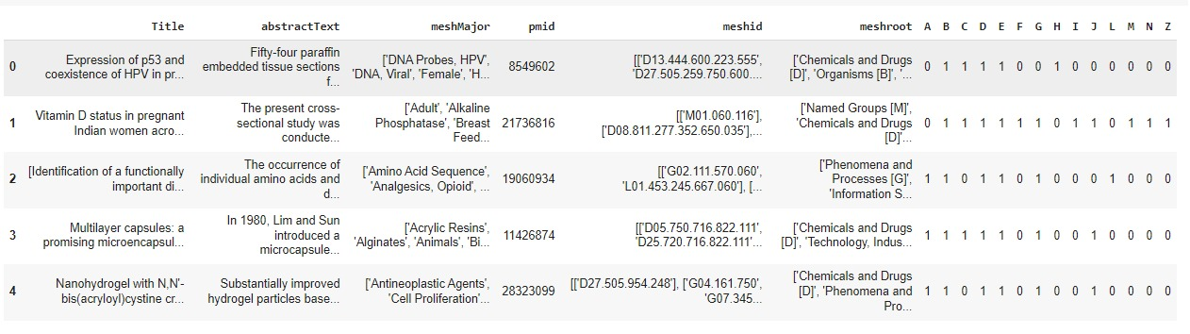
Continuation
To design features from this dataset, we can use techniques such as:
Text preprocessing: tokenization, stopword removal, stemming or lemmatization, and vectorizing text features such as titles and abstracts.
Encoding categorical variables: one-hot encoding for categorical features like mesh terms and mesh categories.
Feature engineering: creating new features from text data, like word counts, tf-idf scores or word embeddings.
Combination of features: the process of concatenating or merging various kinds of features to produce a feature matrix for modeling.

Slide 9
Data Preprocessing
Loading the Dataset: The code loads the dataset from a CSV file named "PubMed.csv" through pandas' read_csv function.
Choice of Features: This includes features picked for the analysis like abstract text (abstractText) and mesh labels (MeshTitleCategories).
One-Hot Encoding Labels: This code changes the multi-label mesh groups into one-hot encoded vectors, making them applicable for multi-label classification.
Tokenization: The abstract text is tokenized using word_tokenize function from NLTK, which means it is divided into single words for more detailed handling.
Training of Doc2Vec Model: We train a Doc2Vec model using the tokenized abstracts to create document embeddings, which store semantic details regarding the text.

Slide 10
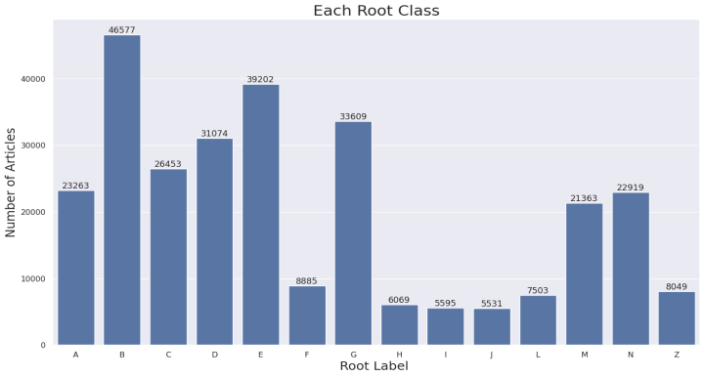
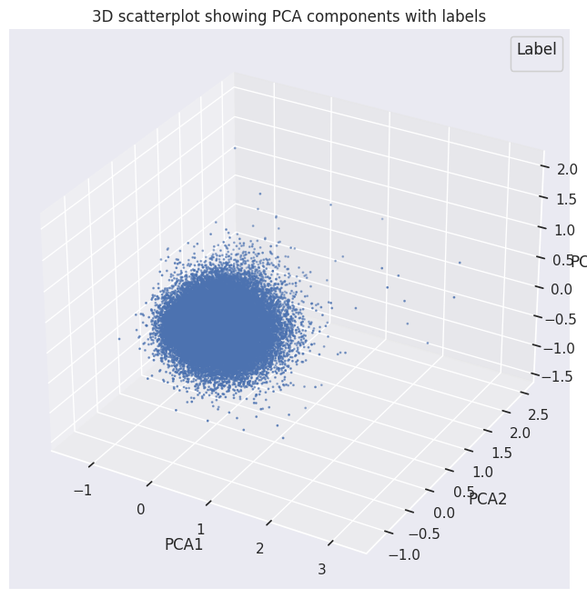
Data Visualization
Bar Plot of Mesh Labels: The code makes a bar plot that shows how articles are spread over different Mesh categories. This helps in knowing the frequency of articles linked with each particular category.
PCA Scatter Plot: In this code part, we create document embeddings using the Doc2Vec model. Then, we use PCA to decrease the dimensionality of these embeddings into three dimensions. After that, it shows a scatter plot in 3D where every dot signifies an article and its colour symbolizes the Mesh label for that particular article. This way of plotting aids in showing how articles cluster together within the embedding area because of their semantic likeness.

Slide 11
Implementation
Data Loading and Exploration
Load the dataset from the "PubMed.csv" file
Data Preprocessing
Tokenize the text data using word_tokenize()
Create tagged documents (TaggedDocument) for Doc2Vec model training
Doc2Vec Model Training and Vector Representation
Train the Doc2Vec model on the tagged documents
Infer vector representations for the documents using the trained Doc2Vec model
PCA Visualization
Perform Principal Component Analysis (PCA) on the document vectors
Reduce dimensionality to 3 components
Visualize the document vectors in a 3D scatter plot, colored by labels

Slide 12
Continuation
Classification models
Split the data into training and testing sets
For each classification model (logistic regression, neural networks, SVM):
Train the model on the training set
Make predictions on the test set
Evaluate the model (overall accuracy, per-class accuracy)
Print the performance metrics
Text summarization
Load the pre-trained BART model and tokenizer
Define a function to summarize text using the BART model
Demonstrate text summarization by generating a summary for one of the abstracts

Slide 13
Integration of the NLP techniques used and uniqueness
The project brings together a variety of techniques and models in natural language processing (NLP) to handle tasks like text representation, dimension reduction, classification and summarizing on a biomedical dataset. Here is an extensive explanation about the NLP techniques employed in this work along with their distinctiveness:
Text Processing:
The project uses NLTK’s word_tokenize to break down text into smaller pieces, making it ready for deeper examination.
Document Vectorization:
It uses Gensim’s Doc2Vec to create detailed representations of entire texts, improving understanding of their overall context.

Slide 14
Continuation
Dimensionality Reduction:
PCA simplifies the complex data into three main elements, making it easier to look for patterns and analyze the data visually.
Model Evaluation:
The work assesses different statistical models like Logistic Regression, Neural Networks, and SVMs to see which one best fits the data based on precision and compatibility.
Summarizing Text:
A pre-trained BART model is employed to condense long texts into brief summaries, helping to highlight essential information quickly.
The uniqueness of this code is in the way it brings together many NLP methods and models. These include things like text representation (Doc2Vec), lessening size (PCA), classification (Logistic Regression, Neural Networks, SVM) and summary writing for texts (BART).

Slide 15
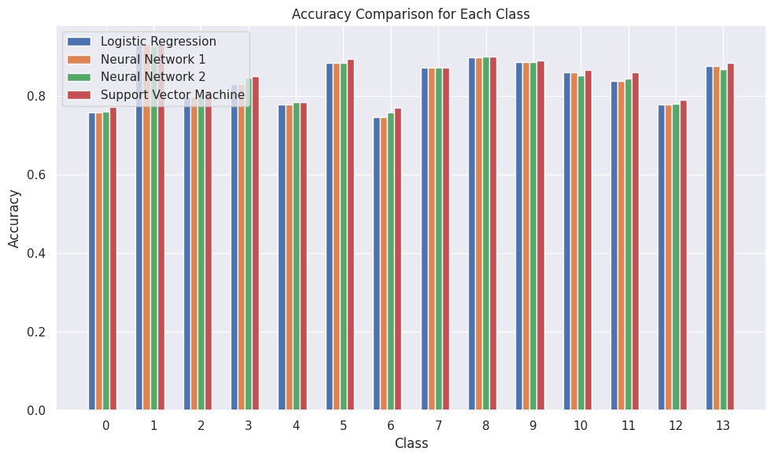
Results and Uniqueness
Several cutting edge methods and models from the natural language processing (NLP) domain are combined in the code. Even though the code's parts (Doc2Vec, PCA, classification models) are not new ideas, this uniqueness comes from how these methods are brought together and applied on the biomedical text data. Also, including a top text summarization model such as BART adds to its distinctiveness.
This mix of methods and models makes for a thorough examination and handling of the text information by using various NLP approaches to get useful understandings and complete different tasks within dataset.
This code is like a base example and can be expanded or modified to include new ways or models that come up in the fast-changing area of natural language processing.

Slide 16
Project Management
The project is about making the analysis of scientific articles automatic. We use natural language processing (NLP) methods for classifying and summarizing texts. This includes preparing the dataset, training models with machine learning, and using transformers to make short summaries of articles. We aim to simplify getting important information from lots of text data quickly.

Slide 17
Issues And Concerns
Variability in Performance: Machine learning models can work more or less effectively depending on the dataset and problem area, so we need to evaluate and choose with care.
Data Quality: It is very important to have a dataset that has good quality and remains consistent. This helps in conducting reliable analysis and training models.
Interpretability: Even if document embeddings are shown visually, understanding the semantic connections among articles might still be difficult.
Scalability: Making the solution larger to handle bigger datasets or different fields might need thinking about optimization and managing resources.
BART (BIDIRECTIONAL AND AUTO-REGRESSIVE TRANSFORMERS): BART is employed, which can produce brief summaries for the scientific articles. It uses transformer design and pre-training on huge text groups to summarize well.

Slide 18
Roles and Responsibilities
Vivek(25%) - responsible for the data preprocessing, features extraction and making the report.
Sathwika(25%) - responsible for visualiziling the data,conversion of text to vectors dimensionality reduction using PCA and making the report.
Hemanth(25%) - responsible for classification of the data using neural networks, relu activation function,SVM and making the report.
Tagore(25%)- responsible for summarizing the data using bart and making the report.

Slide 19
Description
We are a team of four people worked on the Domain Specific Document Summarization through Hierarchical Classification using Transformers
Vivek- worked on data preprocessing, features extraction
Sathwika - worked on visualizing the data, conversion of text to vectors dimensionality reduction using PCA.
Hemanth - worked on classification of the data using neural networks, relu activation function and SVM.
Tagore - summarized the data using bart model.

Slide 20
References/Bibliography:-
Shetty, Chidanand, et al. “Movie Review Prediction System by Real Time Analysis of Facial Expression.” 2021 6th International Conference on Communication and Electronics Systems (ICCES). IEEE, 2021.
Liu, Yiming, Xuezhi Cao, and Yong Yu. “Are You Influenced by Others When Rating? Improve Rating Prediction by Conformity Modeling.” Proceedings of the 10th ACM Conference on Recommender Systems. 2016.
https://www.cs.cornell.edu/people/pabo/movie-review-data/
https://livebook.manning.com/book/real-world-machine-learning/chapter-8/
http://xxx.lanl.gov/abs/cs/0409058

Slide 21
THANKYOU!

